Slide 1

POWER SLIDES
2026

Slide 2

When the ear makes you re-see the ad: the "visual transfer" effect
Neuro visual attention score while listening to the audio ad
+2.1 pts
visual activation gained from prior exposure to the TV ad
Source: Talpa Media × Unravel (NED), Neuro Visual Transfer study (n=40). Index scale −10 to +10; axis truncated at 4 for readability
POWER SLIDES 2026

Slide 3

TV is the biggest profit driver
Bubble size proportional to sales contribution
ROI Index – 100 = all channels average
Print
Influencers
Linear TV
Audio
BVOD
Online video
OOH
% of spend
Paid social
Generic PPC
Cinema
Online display
Source : Go Big or Go Home (2026) – IPA – UK
POWER SLIDES 2026

Slide 4
TV remains the most profitable medium in the media mix
Cross-sector 2022-2024
Bubble size proportional to investments
TOTAL R.O.I. = Short + Long Term
Total R.O.I.
Contribution to additional media sales in %
41% contribution to TV sales
6.1 Total ROI
35% share of investments
Source : ADMTV – Ekimetrics – #ROITV6: TV/Streaming, Immediate effects & Lasting results – Nov. 2025
POWER SLIDES 2026

Slide 5
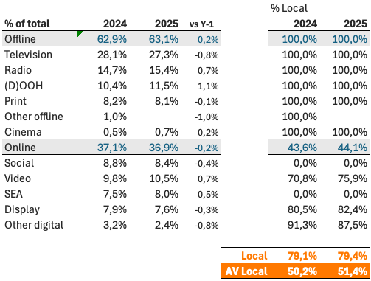
The Belgian market mainly relies on Local sales houses
% Net media spends 2025
International
20,6%
Local
79,4%
Source : UMA-UBA Benchmark 2025 – Direct sales declarations by VIA and BPX members
POWER SLIDES 2026

Slide 6
Total video = Linear TV + BVOD
North
South
TV
52%
Incremental Reach
11%
TV
52%
Incremental Reach
7%
BVOD
24%
BVOD
14%
Total Reach
63%
Total Reach
59%
Source : CIM ToVA planner – 18-54 – November 2025 – 330 GRP - Budget split TV/BVOD : 80/20 in the North and 85/15 in the South
POWER SLIDES 2026

Slide 7
Streaming audio platforms add limited reach
North
South
88%
79%
82%
70%
Streaming
Radio
Source : Audio Time 2025 – 18-54
POWER SLIDES 2026

Slide 8
TV is the battery that charges other media
% average reduction in Purchase Intent over 8 weeks if TV is NOT included alongside…
Other online (search, display) | Audio (radio & streaming) | Social Media | Online Video | Print (physical) | OOH
Source : Thinkbox. Staying Power: The longevity of advertising, Tapestry Research, 2025. Purchase Intent (‘definitely consider’): All brands, among those exposed (nat rep, 18-75). Online Video is mostly YouTube
POWER SLIDES 2026

Slide 9
Top trust-building for-profit campaigns report more business effects
+65%
Average number of very large business effects recorded per campaign
Source : IPA Effectiveness Databank – N = 812 for-profit campaigns
POWER SLIDES 2026

Slide 10
Twice as many people trust brands advertised on TV than YouTube
% of people that trust brands that advertise on…
18+
18-34
YouTube
Radio/
podcasts
Newspapers/
Magazines
Source : Thinkbox / Tapestry Research 2025. Q. : Thinking about different places in which you see advertising, please tell us how you feel [TRUSTED] about brands that advertise [TYPE OF AD]
POWER SLIDES 2026

Slide 11



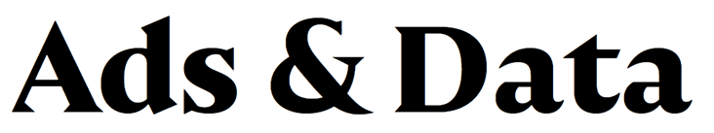


About VIA
VIA unites the sales organisations of the Belgian Audio-Visual media (Video, Audio, Cinema), and has the following goals:
• Stimulate consultation between the members
• Connect in order to develop new initiatives in the market
• Facilitate consultation about technology
• Promote the power of our media, by setting up joint research that support our current offer & future developments
• Support the setup of measurement and reporting of media, help to achieve consensus and bring together our experts
• Represent its members towards other associations
Contact
Ludovic de Barrau
Secretary General ludovic@viabelgium.media
Thinkvia.be

