Slide 1

POWER SLIDES
2026

Slide 2

Social media & online video show more decay
in purchase intent than TV
Exposed to TV
Exposed to online video
Exposed to social media
Source : Thinkbox. Staying Power: The longevity of advertising, Tapestry Research, 2025. Purchase Intent (‘definitely consider’): All brands, among those exposed (nat rep, 18-75). Online Video is mostly YouTube
POWER SLIDES 2026

Slide 3
TV is the battery that charges other media
% average reduction in Purchase Intent over 8 weeks if TV is NOT included alongside…
Other online (search, display) | Audio (radio & streaming) | Social Media | Online Video | Print (physical) | OOH
Source : Thinkbox. Staying Power: The longevity of advertising, Tapestry Research, 2025. Purchase Intent (‘definitely consider’): All brands, among those exposed (nat rep, 18-75). Online Video is mostly YouTube
POWER SLIDES 2026

Slide 4
Top trust-building for-profit campaigns report more business effects
+65%
Average number of very large business effects recorded per campaign
Source : IPA Effectiveness Databank – N = 812 for-profit campaigns
POWER SLIDES 2026

Slide 5
Twice as many people trust brands advertised on TV than YouTube
% of people that trust brands that advertise on…
18+
18-34
YouTube
Radio/
podcasts
Newspapers/
Magazines
Source : Thinkbox / Tapestry Research 2025. Q. : Thinking about different places in which you see advertising, please tell us how you feel [TRUSTED] about brands that advertise [TYPE OF AD]
POWER SLIDES 2026

Slide 6
POWER SLIDES
2025

Slide 7
Impact of advertising and media on the Belgian economy
Direct Impact
€ 4,1 bn
Broader Impact
€ 15,1 bn
Broadcasting and publishing services
Information technology services
Advertising agencies
Film, TV and video production
PR
Informed consumers
Enhanced competition
Multiplier-effects broader economy
National visibility and reputation
New export markets, FDI, tourism, talent
Source : Econopolis / Ortelius model (based on nominal numbers)
POWER SLIDES 2025

Slide 8
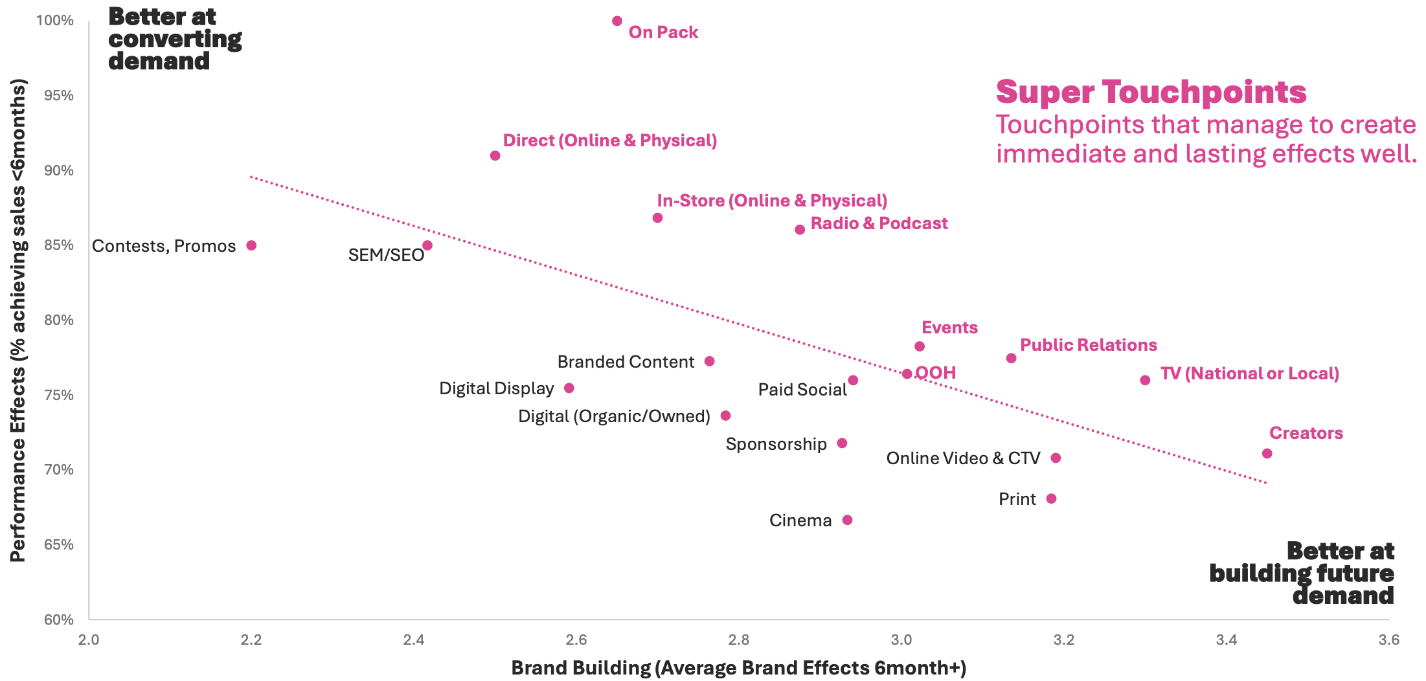
TV and Radio create immediate and lasting effects
Source : System 1 & Effie – The Creative Dividend – 1.265 Europe, US, UK & Ireland campaigns between 2007-2023 from Effie Case Library
POWER SLIDES 2025

Slide 9
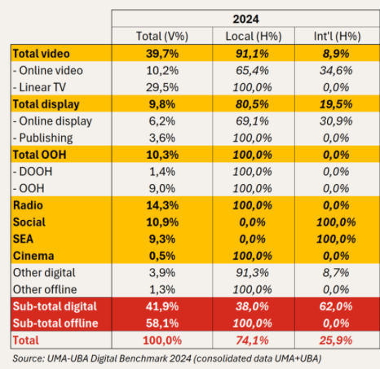
The Belgian market mainly relies on local sales houses
% media net spends 2024
International
25,9%
Local
74,1%
Source : UMA-UBA Benchmark 2024
POWER SLIDES 2025

Slide 10
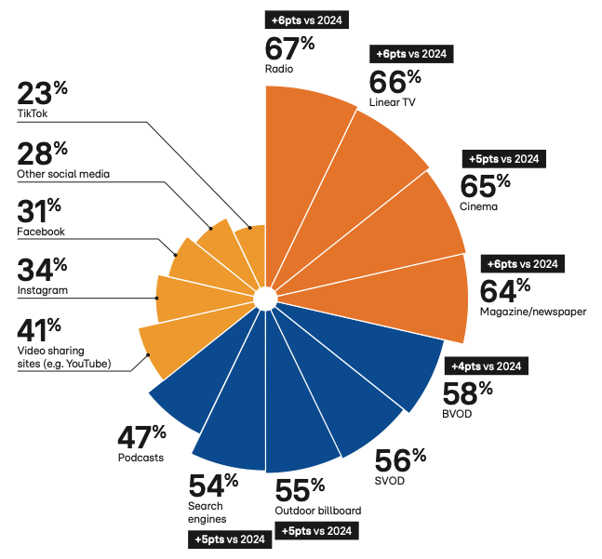
Ads on local media are the most trusted
% of people that trust a brand (somewhat or very much) after seeing or hearing an ad
Source : RTL AdAlliance – Study “The New Life of the Living Room” 2025. Basis : Users of the platforms. Europe 14 countries
Q. : How much do you trust a brand that you don’t know after seeing or hearing an ad on these different media?
POWER SLIDES 2025

Slide 11
Streaming audio platforms add limited reach
NORTH
SOUTH
RADIO
82%
RADIO
73%
RADIO
74%
RADIO
64%
Source : CIM Audio Time 2024 & 2025, on target 18-54. Hypothesis: % of FREE streamers is the same in the Exclusive versus the Overlapper category
POWER SLIDES 2025

Slide 12
BVOD’s incremental reach keeps growing
NORTH
SOUTH
TV
50%
Incremental Reach
12%
TV
52%
Incremental Reach
6,5%
BVOD
24%
BVOD
14%
Total Reach
62%
Total Reach
59%
Source : CIM ToVA planner, 18-54, Feb. 2025. 330 GRP. Budget split TV/BVOD 2025 : 85/15 in the South and 80/20 in the North
POWER SLIDES 2025

Slide 13
In Belgium, 83% of all casted audio ads are delivered by Radio broadcasters
83 %
Sources : CIM Audio Time 2024 – Target 18-54 – Estimation of time spent hearing ads : CIM RAM Sept. 23 - Aug. 24 – For Audio Streaming and Podcasts : VIA estimates.
POWER SLIDES 2025

Slide 14
Among the 18-34 target group 71% of audio adv. comes from radio broadcasters
71 %
Sources : CIM Audio Time 2024 – Target 18-34 – Estimation of time spent hearing ads : CIM RAM Sept. 23 - Aug. 24 – For Audio Streaming and Podcasts : VIA estimates.
POWER SLIDES 2025

Slide 15
Radio Broadcasters share equivalent in North and South of the country
80%
84%
Sources : CIM Audio Time 2024 – Target 18-54 – Estimation of time spent hearing ads : CIM RAM Sept. 23 - Aug. 24 – For Audio Streaming and Podcasts : VIA estimates.
POWER SLIDES 2025
Notes:
0

Slide 16






About VIA
VIA unites the sales organisations of the Belgian Audio-Visual media (Video, Audio, Cinema), and has the following goals:
• Stimulate consultation between the members
• Connect in order to develop new initiatives in the market
• Facilitate consultation about technology
• Promote the power of our media, by setting up joint research that support our current offer & future developments
• Support the setup of measurement and reporting of media, help to achieve consensus and bring together our experts
• Represent its members towards other associations
Contact
Ludovic de Barrau
Secretary General
ludovic@viabelgium.media
Thinkvia.be

