Slide 1
POWER SLIDES
2025

Slide 2
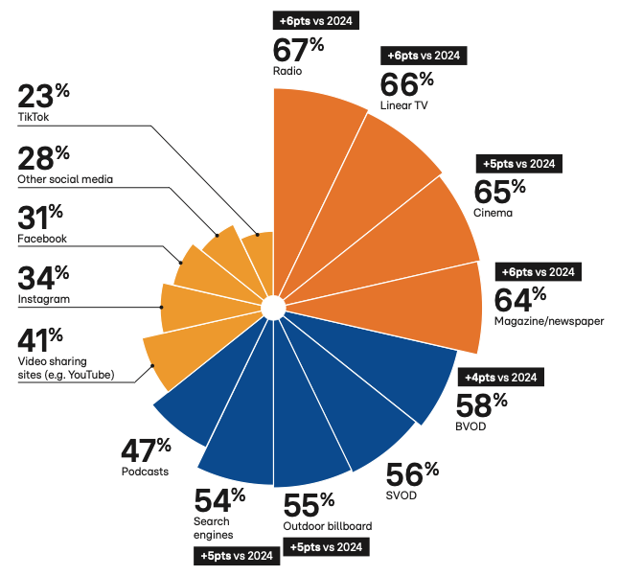
Ads on local media are the most trusted
How much do you trust a brand that you don’t know after seeing or hearing an ad on these different media?
Somewhat, or very much trust.
Source : RTL AdAlliance – Study “The New Life of the Living Room” 2025. Basis : Users of the platforms. Europe 14 countries
POWER SLIDES 2025

Slide 3
Streaming audio platforms add limited reach
NORTH
SOUTH
RADIO
82%
RADIO
73%
RADIO
74%
RADIO
64%
Source : CIM Audio Time 2024 & 2025, on target 18-54. Hypothesis: % of FREE streamers is the same in the Exclusive versus the Overlapper category. Click here for more info.
POWER SLIDES 2025

Slide 4
BVOD’s incremental reach keeps growing
NORTH
SOUTH
TV
50%
Incremental Reach
12%
TV
52%
Incremental Reach
6,5%
BVOD
24%
BVOD
14%
Total Reach
62%
Total Reach
59%
Source : CIM ToVA planner, 18-54, Feb. 2025. 330 GRP. Budget split TV/BVOD 2025 : 85/15 in the South and 80/20 in the North
POWER SLIDES 2025

Slide 5
In Belgium, 83% of all casted audio ads are delivered by Radio broadcasters
83 %
Sources : CIM Audio Time 2024 – Target 18-54 – Estimation of time spent hearing ads : CIM RAM Sept. 23 - Aug. 24 – For Audio Streaming and Podcasts : VIA estimates.
POWER SLIDES 2025

Slide 6
Among the 18-34 target group 71% of audio adv. comes from radio broadcasters
71 %
Sources : CIM Audio Time 2024 – Target 18-34 – Estimation of time spent hearing ads : CIM RAM Sept. 23 - Aug. 24 – For Audio Streaming and Podcasts : VIA estimates.
POWER SLIDES 2025

Slide 7
Radio Broadcasters share equivalent in North and South of the country
80%
84%
Sources : CIM Audio Time 2024 – Target 18-54 – Estimation of time spent hearing ads : CIM RAM Sept. 23 - Aug. 24 – For Audio Streaming and Podcasts : VIA estimates.
POWER SLIDES 2025
Notes:
0

Slide 8
About VIA
VIA unites the sales organisations of the Belgian Audio-Visual media (Video, Audio, Cinema), and has the following goals:
• Stimulate consultation between the members
• Connect in order to develop new initiatives in the market
• Facilitate consultation about technology
• Promote the power of our media, by setting up joint research that support our current offer & future developments
• Support the setup of measurement and reporting of media, help to achieve consensus and bring together our experts
• Represent its members towards other associations
Contact
Ludovic de Barrau
Secretary General
ludovic@viabelgium.media
Thinkvia.be

