Slide 1

POWER SLIDES
2025

Slide 2
In Belgium, 83% of all audio ads are delivered by Radio broadcasters
83 %
Sources : CIM Audio Time 2024 – Target 18-54 – Estimation of time spent hearing ads : CIM RAM Sept. 23 - Aug. 24 – For Audio Streaming and Podcasts : VIA estimates.
POWER SLIDES 2025
2
More details click here

Slide 3
POWER SLIDES
Selection 2024

Slide 4
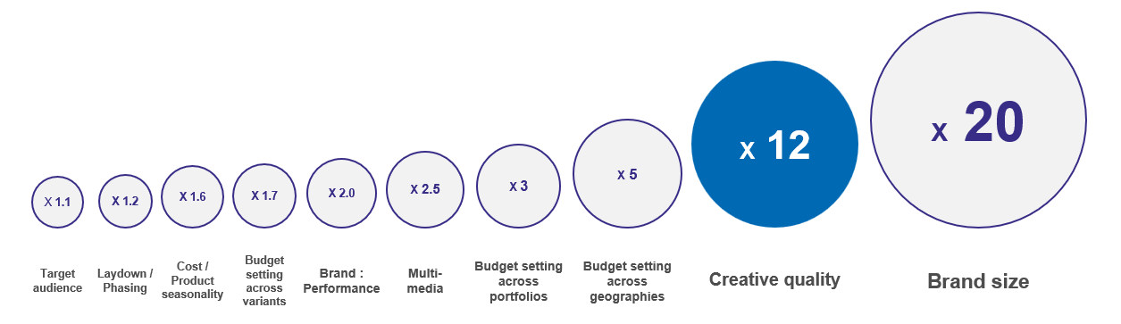

Creativity is the biggest advertising profitability multiplier within our control
Potential multipliers of advertising profitability
Source: The Drivers of Profitability, 2023, Paul Dyson - accelero, ROI multiplier = area of the circle
POWER SLIDES OF 2024
More details click here
Notes:
Thinkbox, end of 2023

Slide 5
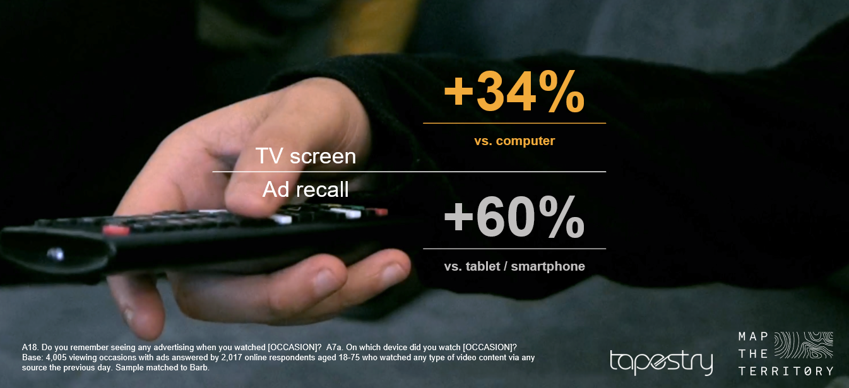
The TV screen drives the highest ad recall of all devices
Source: Context Effects, Map the Territory & Tapestry Research, 2024
POWER SLIDES OF 2024
5
More details click here

Slide 6
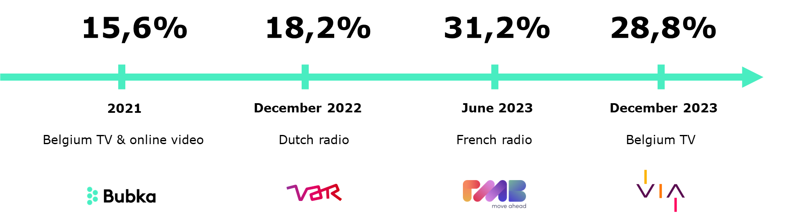

Sustainability claims in communication become more credible
Source : research by Bubka for Var, RMB and VIA - Webinar : More impact for less impact, May 2024
POWER SLIDES OF 2024
6
More details click here

Slide 7
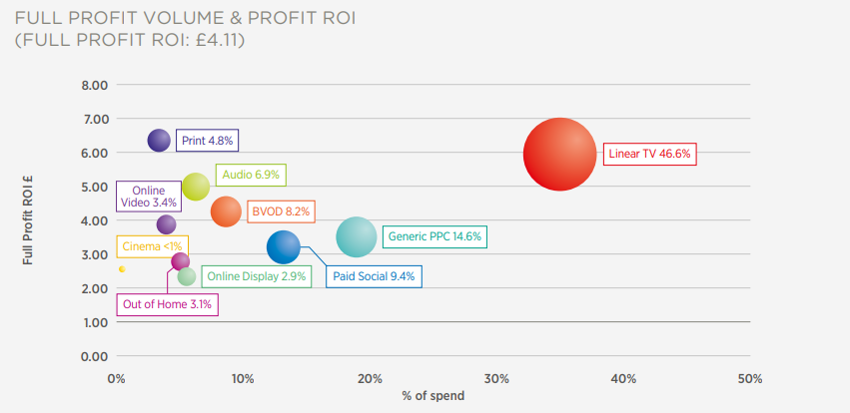
TV (Linear and BVOD) accounts for over half of all ad-driven profit
Source : Thinkbox, Profit ability 2, THE NEW BUSINESS CASE FOR ADVERTISING, April 2024 – Full report
POWER SLIDES OF 2024
7
More details click here

Slide 8
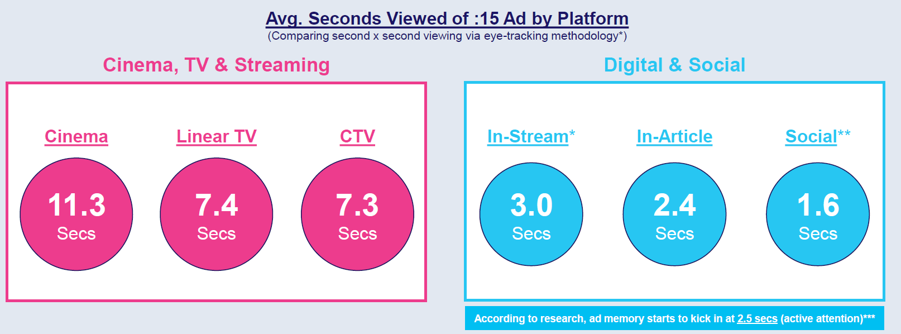
Engagement with long-form video content grabs much higher attention
Source : Laugh, Cry, Share, Buy How TV & Streaming Influences Gen Z More Than Leading Social, VAB USA.
POWER SLIDES OF 2024
8
More details click here

Slide 9
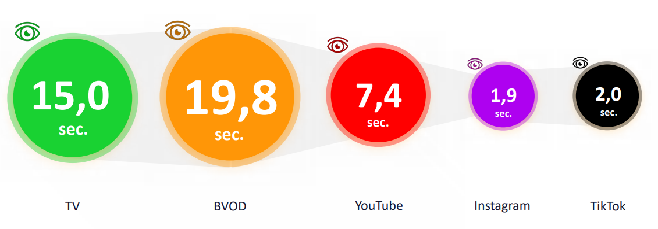
Eyes on Ad: Viewing time (median) of all video advertising contacts per platform in seconds
Source : Into the wild, Screenforce Germany, 2024
POWER SLIDES OF 2024
9
More details click here

Slide 10
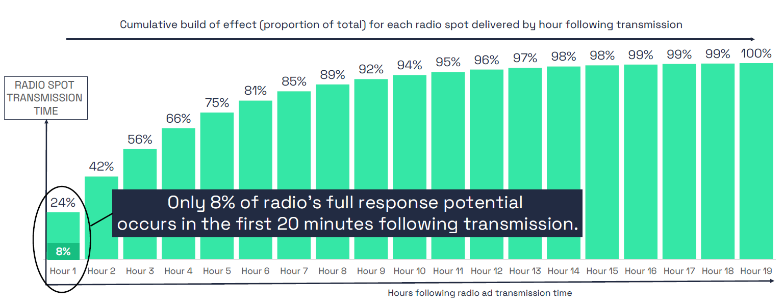
RADIO : 92% of the response comes after the Short Term attribution
Source : Radio, the Performance Multiplier / Radiocentre UK.
POWER SLIDES OF 2024
10
More details click here
Notes:
Webinar 15 october. THE PERFORMANCE MULTIPLIER

Slide 11
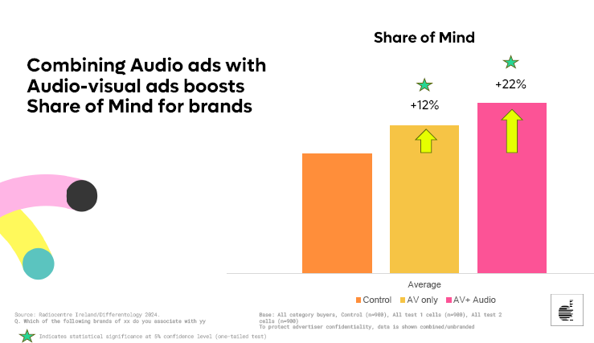
Combining Audio ads with Audio-Visual ads boosts Share of Mind for brands
AV +
Audio
control
AV ONLY
Source : Radiocentre Ireland – Differentology 2024
POWER SLIDES OF 2024
11
More details click here

Slide 12
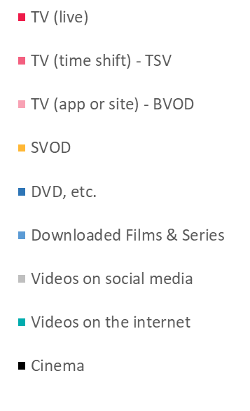
52% of all ads viewed by Gen Z are delivered by TV broadcasters
18-24
Source: Video Observer 2024 – Monday to Sunday – 18-24y – Total Belgium
POWER SLIDES OF 2024
12
More details click here

Slide 13
Time shifted viewing on TV ads extra reach
Source: CIM Audimetrie, Jan-June 2024, All Day, Weighted average North 55%, South 45% Total Belgium
POWER SLIDES OF 2024
13
More details click here

Slide 14
Optimal budget mix varies by sector
TV has the largest share
Source : Media Mix Navigator, 2024. Based on a mass market brand, 11-20% online sales (finance 71-80%), high risk, further details for each category is included in the notes
POWER SLIDES OF 2024
14
More details click here

Slide 15
In Belgium, 87% of all viewed ads are delivered by TV broadcasters
87 %
Source Video Observer 2024 - Estimation of time spent watching ads : CIM TAM Jan-June 24 (for Live TV and TSV) – VIA Jan-June 24 (for BVOD)
For Social Media and internet like in the UK at 4% - For Cinema like in the UK at 8,0%.
POWER SLIDES OF 2024
15
More details click here

Slide 16


